Slide 1
Classification and Text Analysis of Public Comments to Regulations
Arthur Pignotti
Health Insurance Specialist
CMS
Medicare Plan Payment Group
arthur.pignotti@cms.hhs.gov
INFORMATION NOT RELEASABLE TO THE PUBLIC UNLESS AUTHORIZED BY LAW:
This information has not been publicly disclosed and may be privileged and confidential. It is for internal government use only and must not be disseminated, distributed, or copied to persons not authorized to receive the information. Unauthorized disclosure may result in prosecution to the full extent of the law.
Notes:
RECONCILIATION CALCULATIONS use PDE data with a processed date on or before 6/30/2016 cycle 3 (“20160630 Cycle 3”)
DIR data with a processed date on or before 8/31/2016

Slide 2
What Problem Am I Trying to Solve: Classification of Comments for SMEs and Analysis
Problem
+1,000 pages of comments, mostly in PDF form, need to be sorted and read by SMEs
Current Solution
A handful of unlucky people work over the weekend to convert, read and sort the documents
New Solution
Use programming to convert documents and topic modeling to sort them and do analysis

Slide 3
Timeline of Current General Process
SMEs Read through Comments and Create Briefing Materials
Special Team Sorts through Comments
Senior Leadership is Briefed and Some Decisions are Made
Higher Level Leadership is Briefed and Remaining Decisions are Made
SMEs Write and Revise Final Document Text

Slide 4
Approach to Classification
Simplified, high-level explanation of the approach
Method Choice: Topic Modeling (topicmodels package)
Since comments can refer to multiple parts of the regulation, topic modeling, using Latent Dirichlet Allocation (LDA), is a better approach to other standard classification approaches
Since topic modeling is more for clustering instead of classification, must combine model outputs to bridge the comments to the regulation sections via the model topics

Slide 5
Simplify This Workflow with Higher-Level Classification/Topic Modeling Workflow
Apply Topic Model, Which Sorts Comments
Build Topic Model
Clean Comment Data
Convert PDFs and Extract Text
Break Up Document into Sections
Edit Topic Term Weights with SME Input
Download Comments from Regulations.gov or FDMS
Analyze Comments
Build Topic Model from Regulation Document
Prepare Comments for the Model

Slide 6
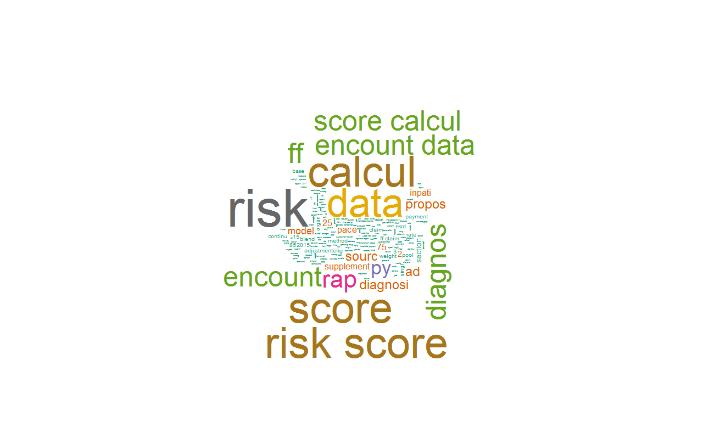
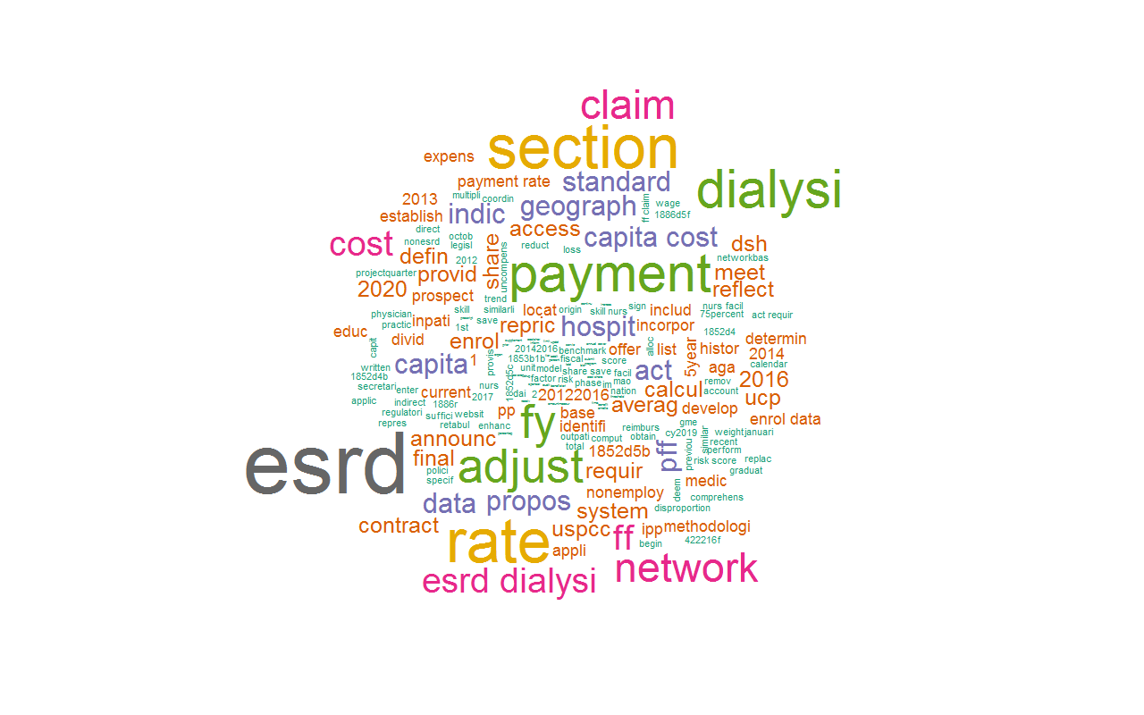
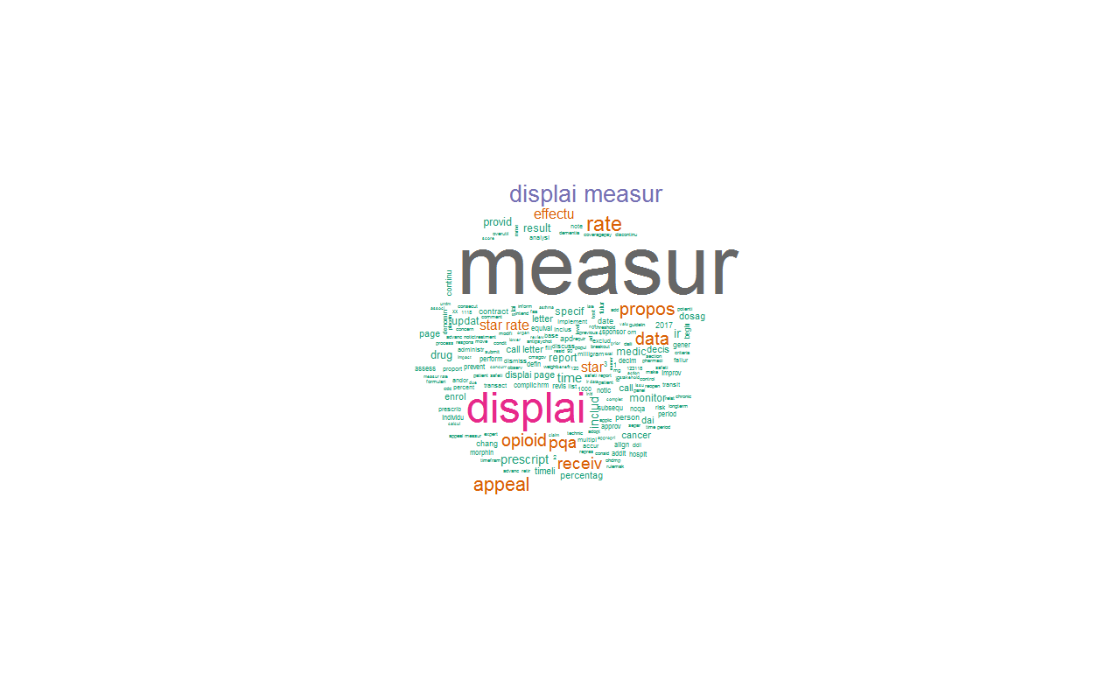
Quick Peek at the Model
Encounter Data as
a Diagnosis Source
Star Ratings:
Display Measures
ESRD Rates

Slide 7
Benefits to Customers
Saves time for all involved
Quicker to briefing, which hopefully will lead to faster decisions (show effect on sample briefing timeline)
Less down time
More time to write final text and/or responses
Allows time for in-depth statistical analysis. Ex:
Comment counts by industry by topic
Possible sentiment analysis

